Slide 1
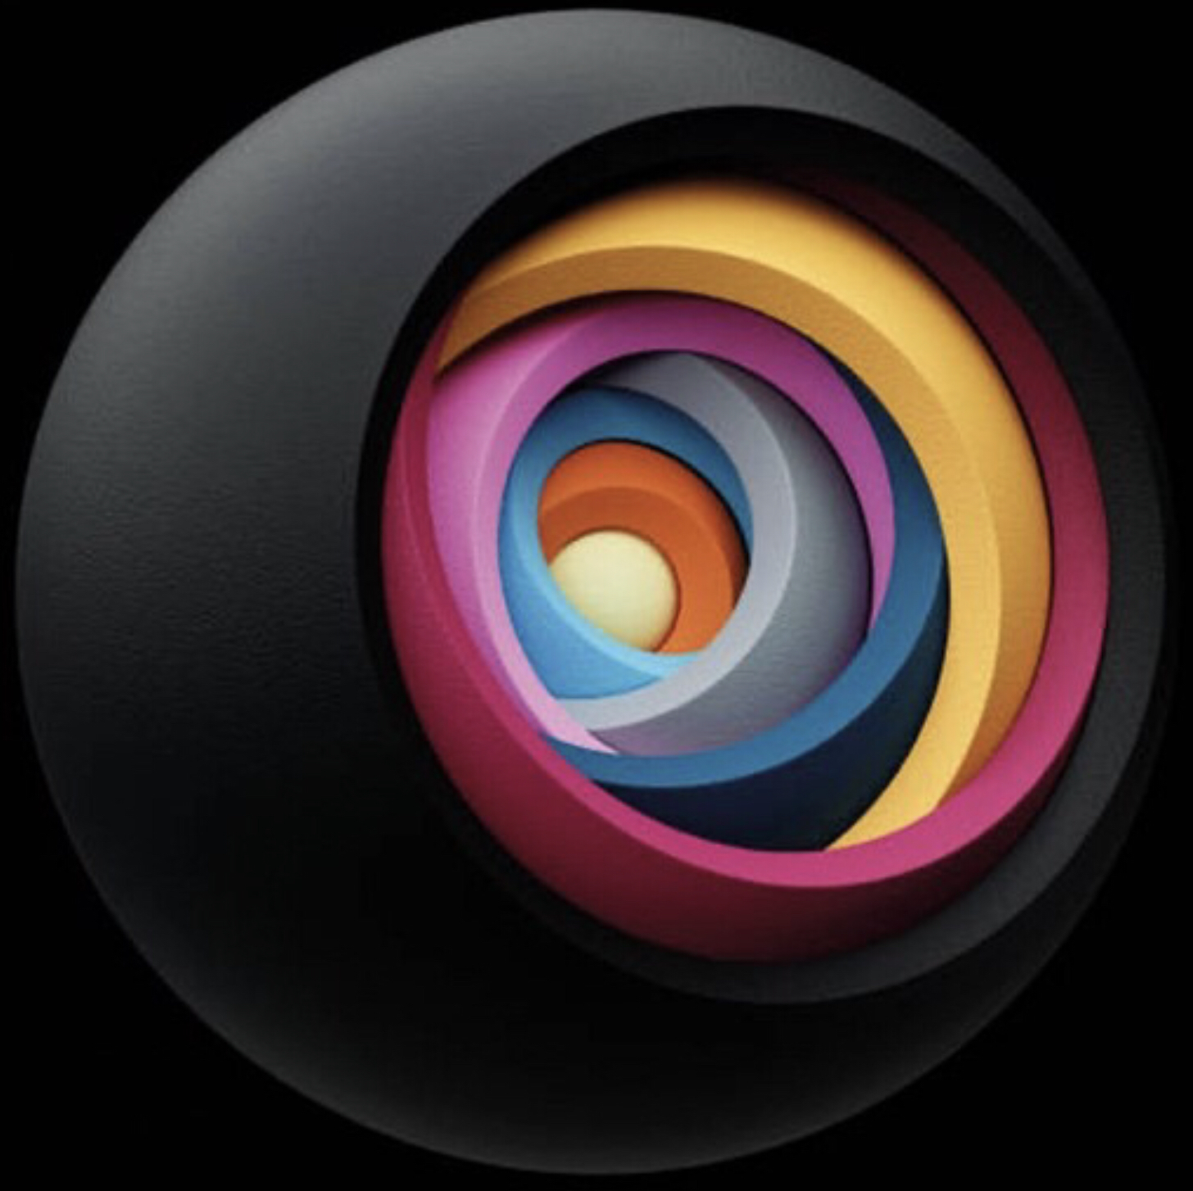
Artificial Intelligence
Neil D. Lawrence

Slide 2
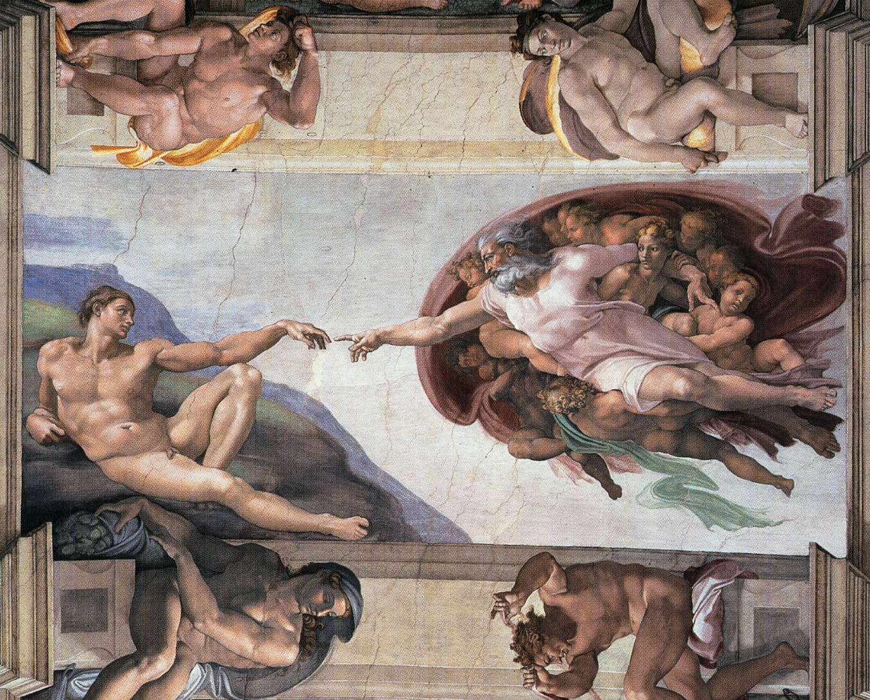

Slide 3
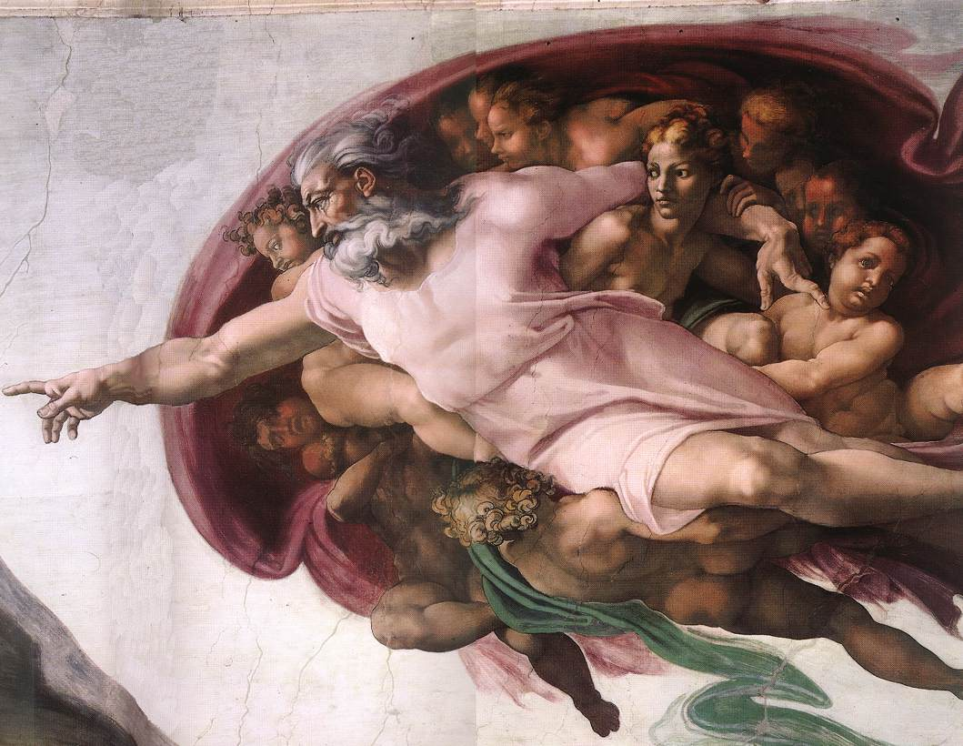

Slide 4

Notes:
The ”Blue Marble” photographed by Apollo 17.

Slide 6

Notes:
The Diving Bell and the Butterfly](https://www.penguinrandomhouse.com/books/9616/the-diving-bell-and-the-butterfly-by-jean-dominique-bauby/) is the autobiography of Jean Dominique Bauby. Jean Dominique was the editor of the French Elle magazine, in 1995 at the age of 43, he suffered a major stroke. The stroke paralyzed him and rendered him speechless. He was only able to blink his left eyelid, he became a sufferer of locked in syndrome.

Slide 7
?
!#@%&?
#
!
&
!
£*?$&!
&
?
#

Slide 8

For Sale, Baby Shoes, Never Worn

Slide 9

Notes:
Chicago Stone, side 2, recording sale of a number of fields, probably from Isin, Early Dynastic Period, c. 2600 BC, black basalt

Slide 10


Slide 11


Slide 12




Slide 13


Slide 14
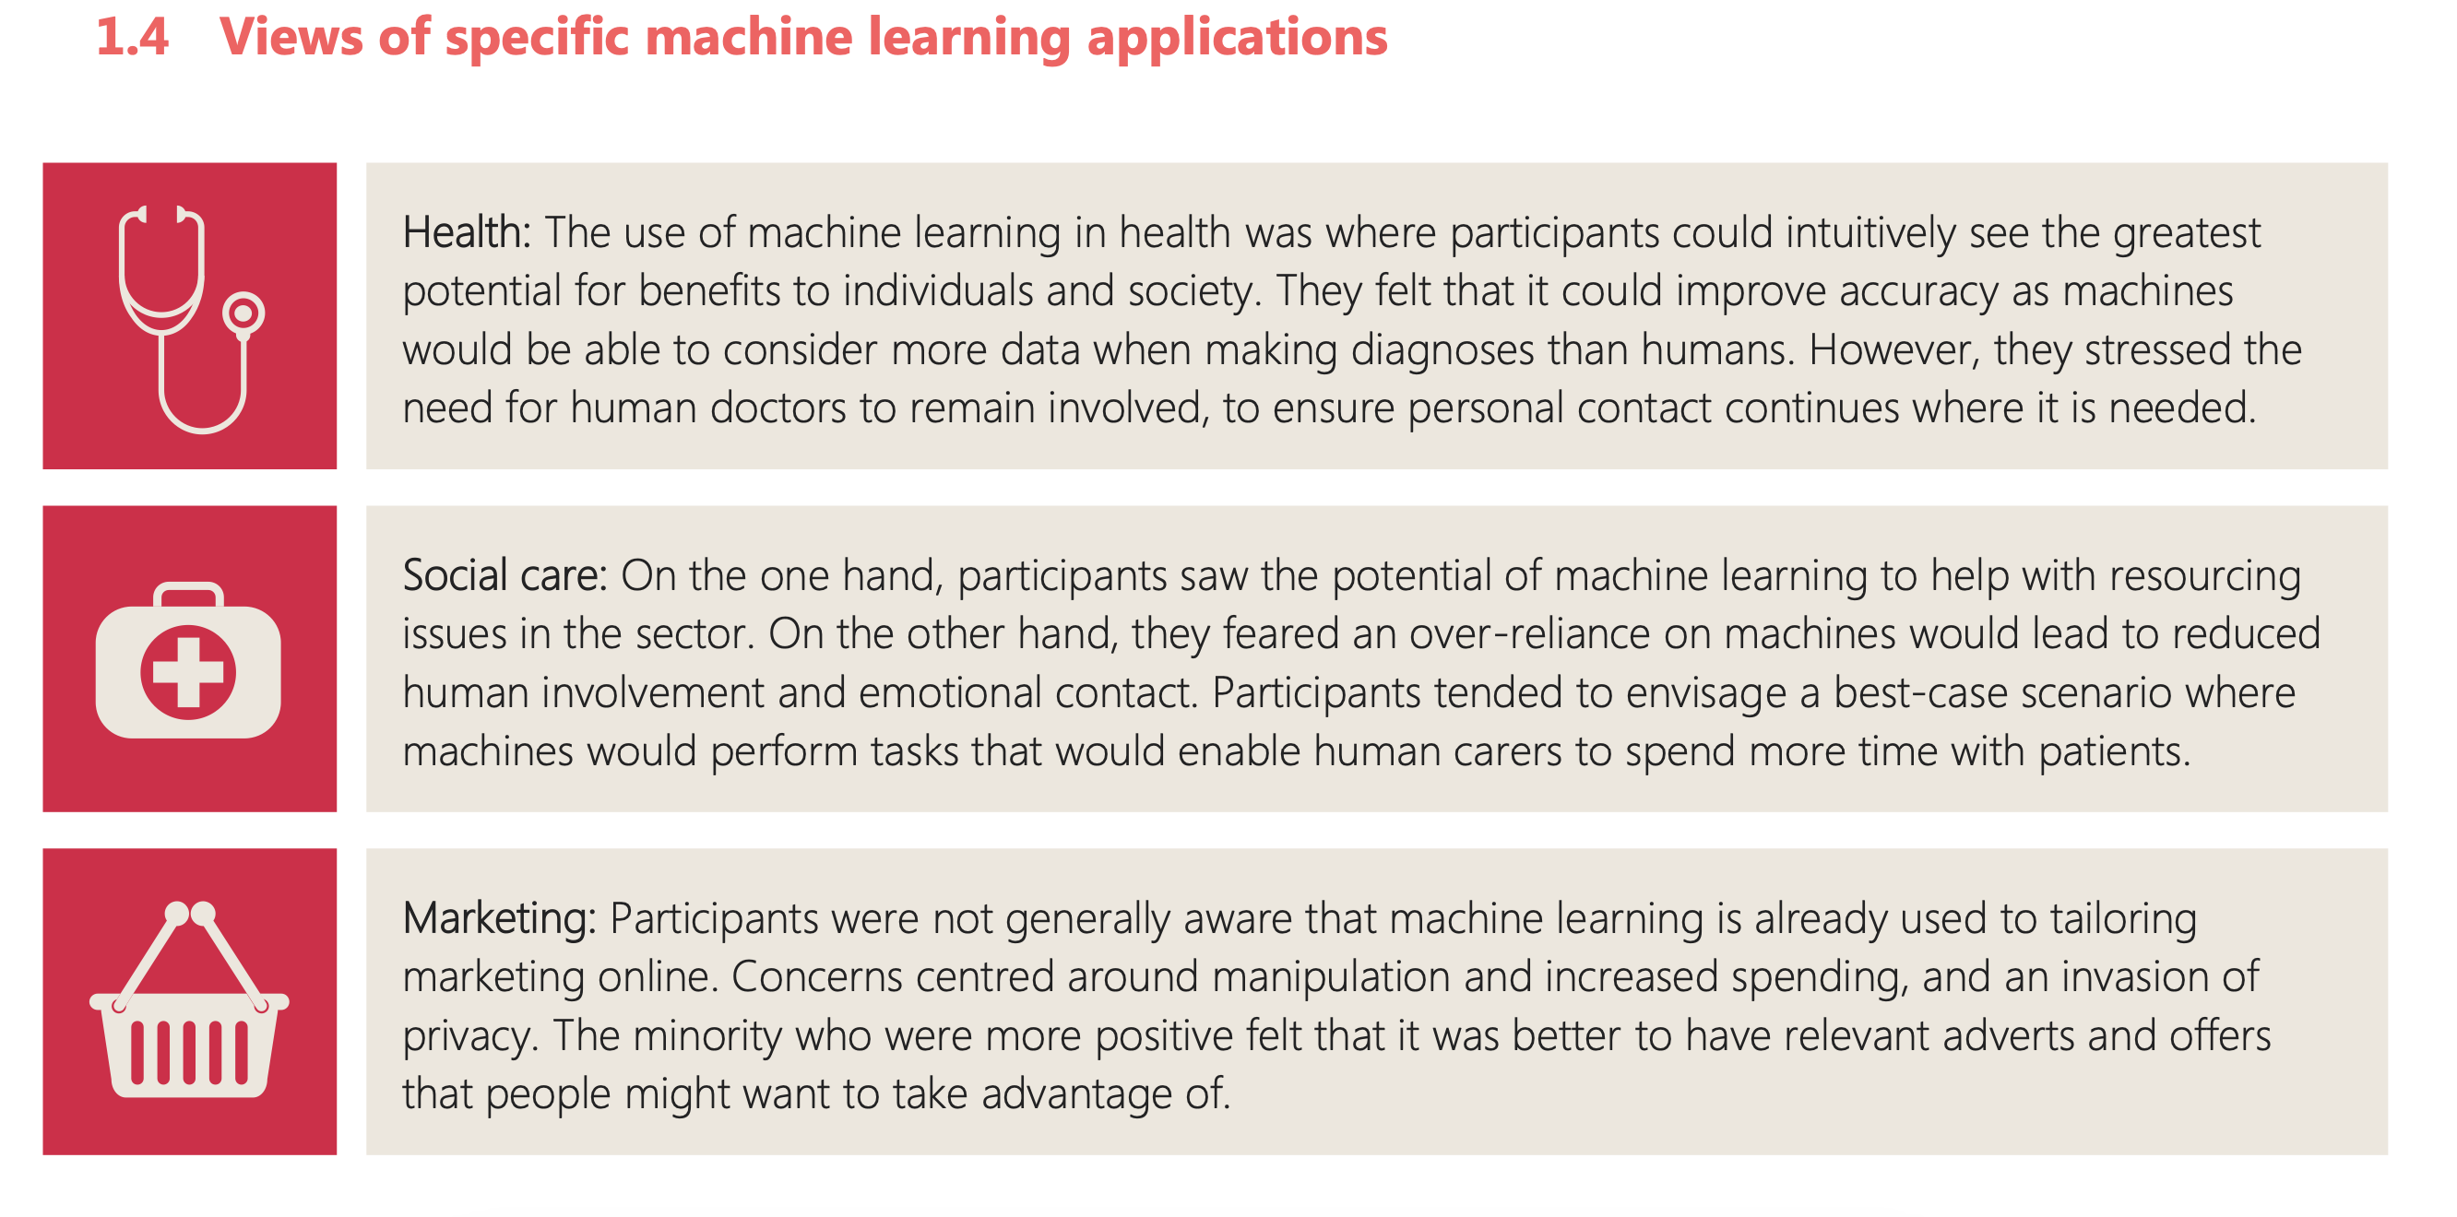

Slide 15
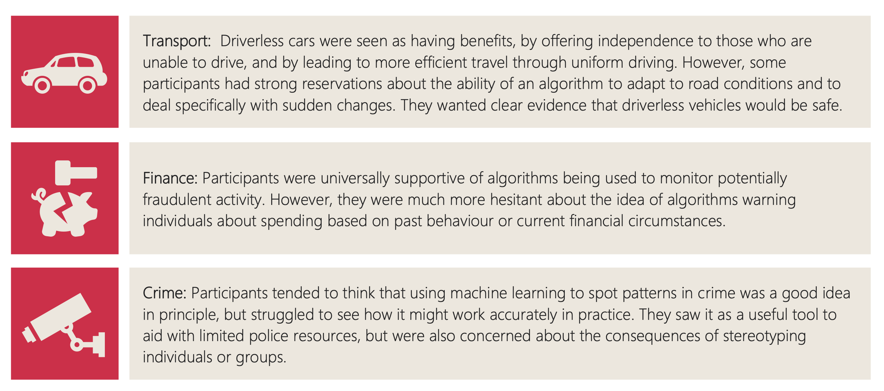

Slide 16
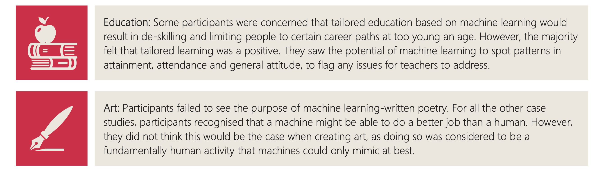

Slide 17
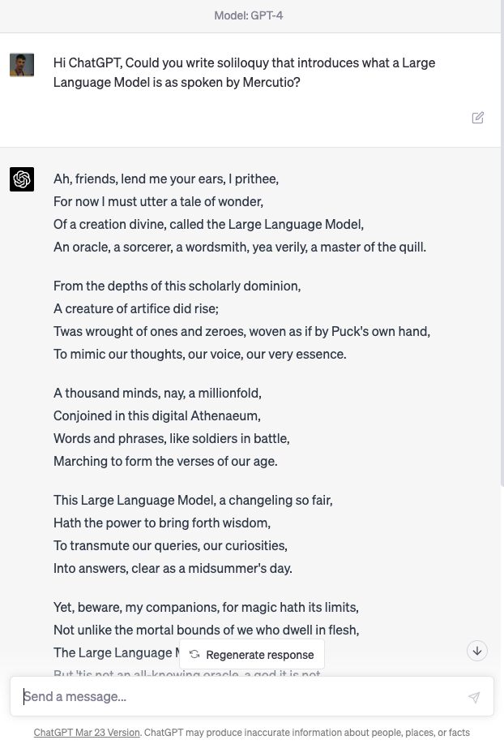

Slide 18


Slide 19


Slide 20
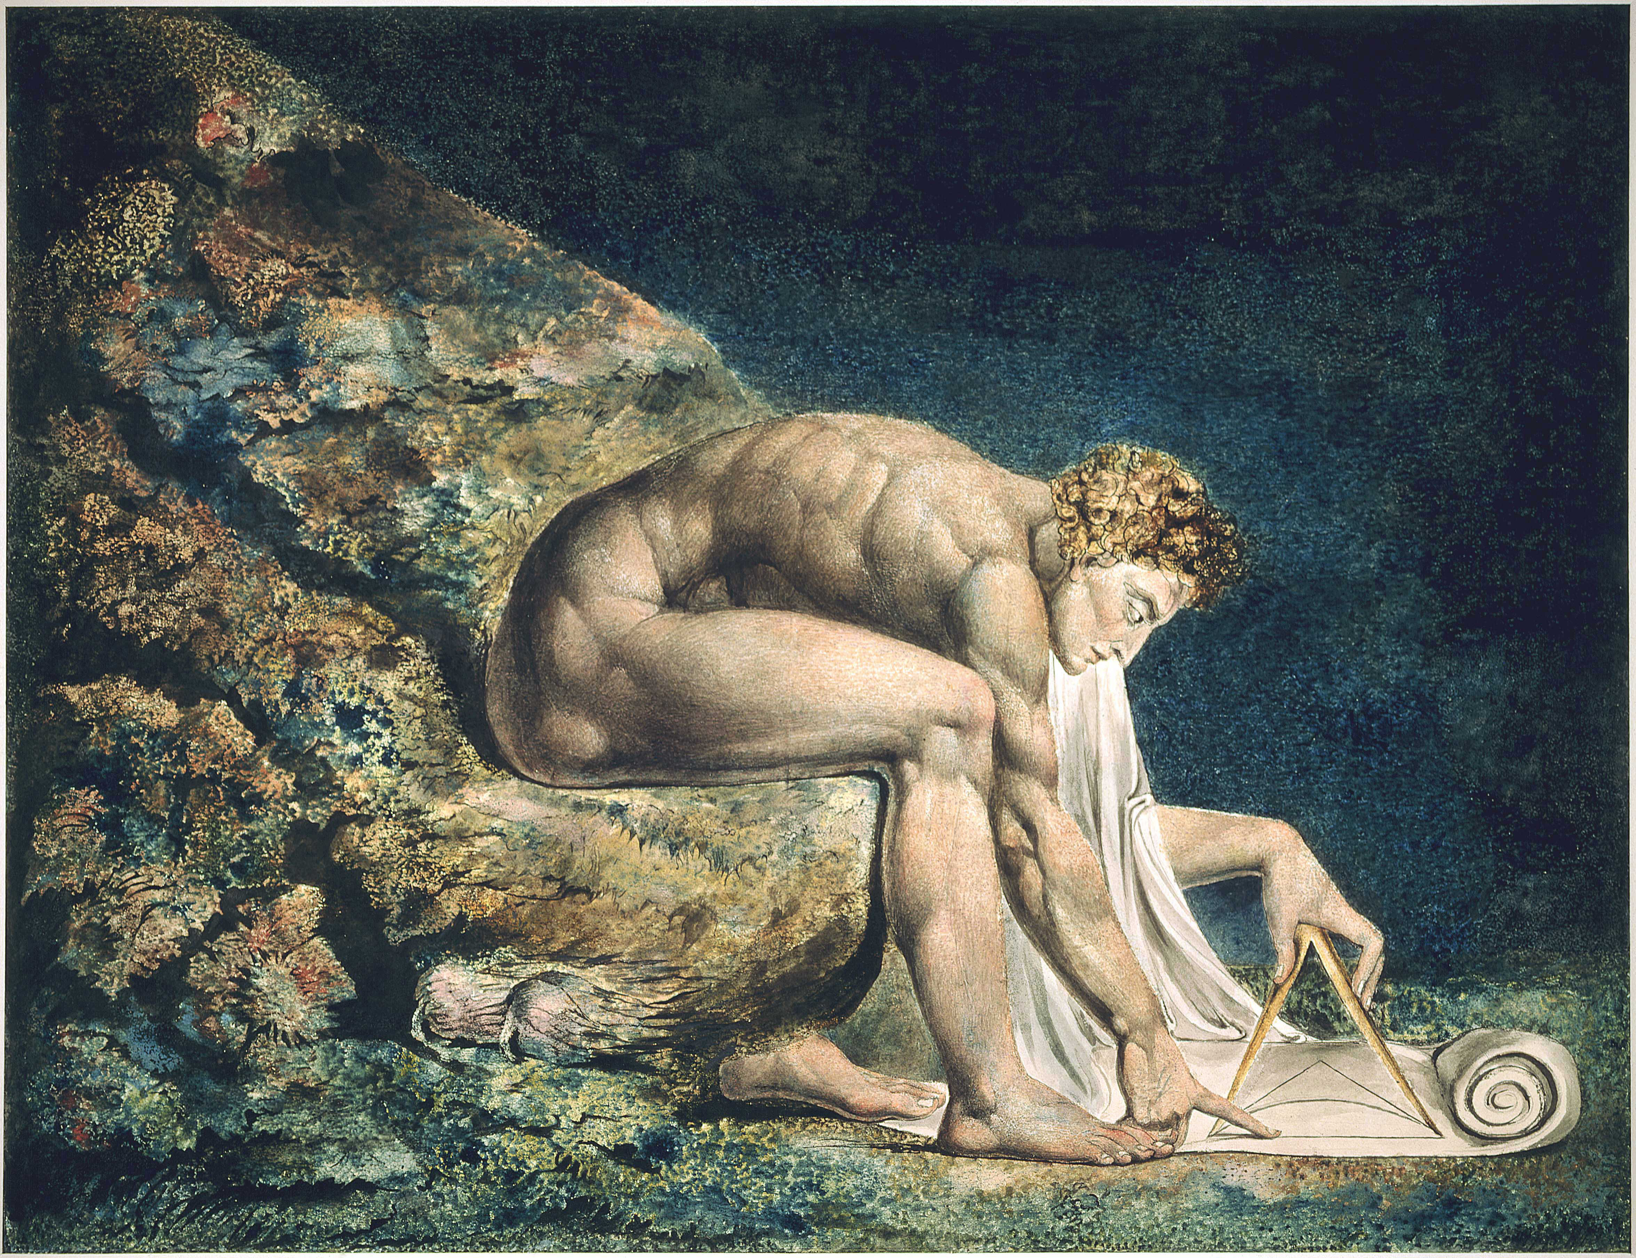

Slide 22
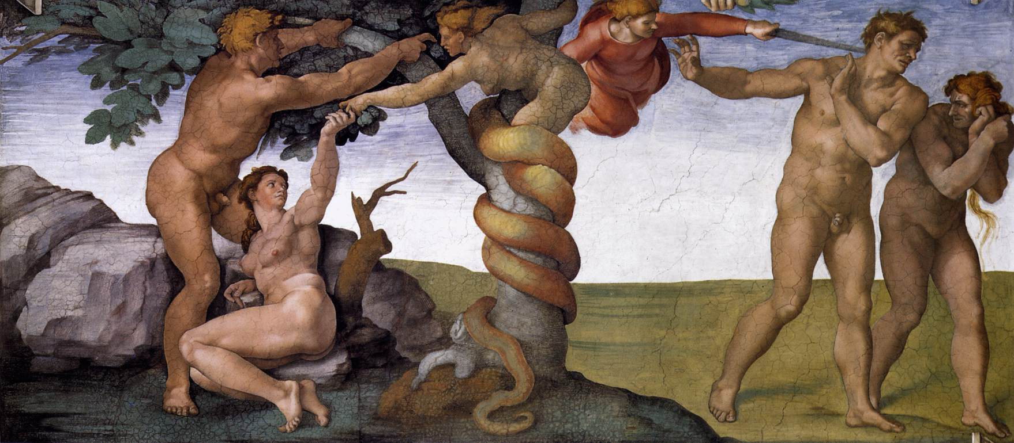

Slide 23
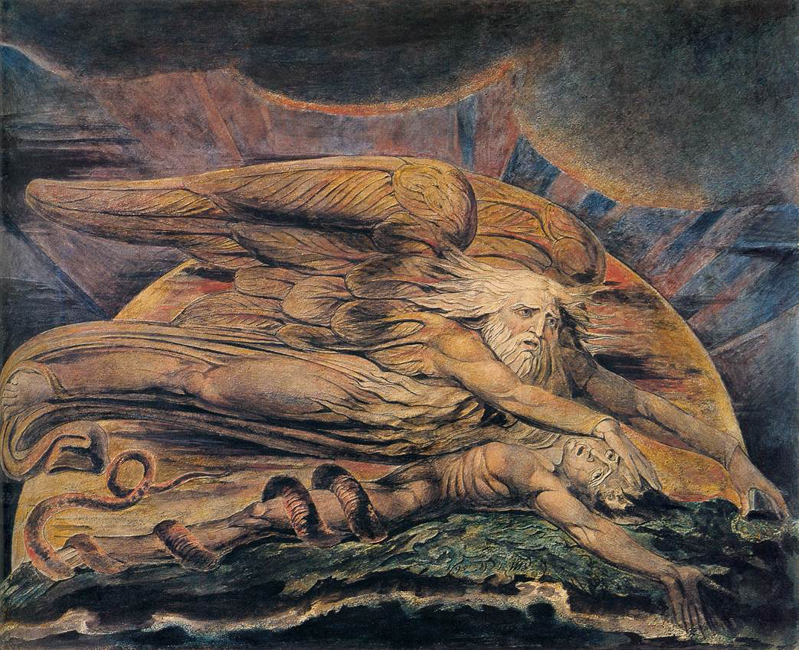

Slide 25
Notes:
The ”Blue Marble” photographed by Apollo 17.

Slide 26
complexity
bandwidth

Slide 27
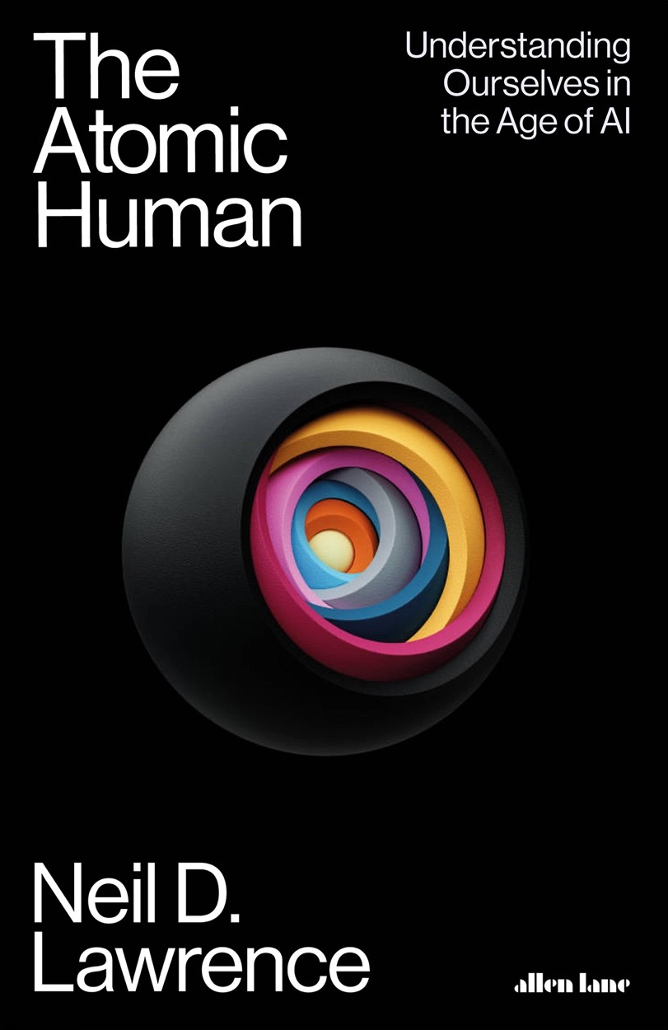
Available Now!
Thanks!

